Slide 1
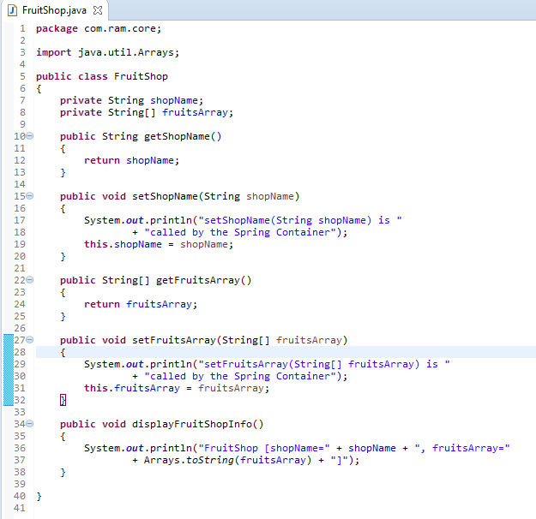
Setter Dependency Injection with Array of String

Slide 2
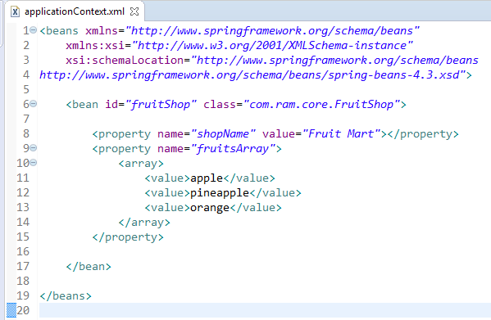
Setter Dependency Injection with Array of String
We are providing the information into the bean by applicationContext.xml file.
The property element invokes the setter method.
The array element is used here to define the array.

Slide 3
Setter Dependency Injection with Array of String
FruitShop
What object to instantiate?
What object to configure and how to configure?
The Spring Container
(ApplicationContext)
applicationContext.xml
FruitShop
Object
shopName=Fruit Mart
listOfAvailableFruits=
[apple, pineapple, orange]
Create the FruitShop object.
Configure the FruitShop object.
Manage FruitShop object complete life cycle from creation till destruction.

Slide 4
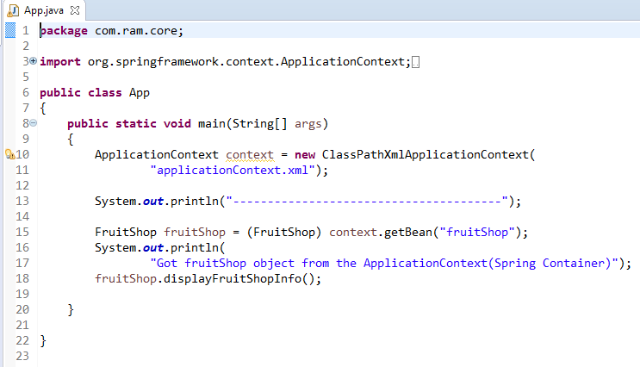
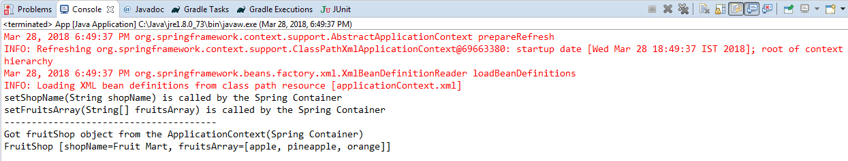
Setter Dependency Injection with Array of String

